Slide 1
Hyperlocal emission tracing using boosted-regression trees
By Alexander Nguyen

Slide 2
objective
Utilizing the machine learning technique, boosted-regression trees, establish a predictive model capable of measuring the contribution of local and freeway traffic towards atmospheric concentrations of NO₂ and PM_{2.5}

Slide 3
Gradient boosted regression tree
Similar to regular regression tree except a weighing step is added and iterated multiple times in order to improve the accuracy of the decision nodes
Decisions are made by the algorithm to create a strong predictive model with weak learners
Best Explained by This Video
https://www.youtube.com/watch?v=3CC4N4z3GJc&list=PLblh5JKOoLUJjeXUvUE0maghNuY2_5fY6

Slide 4
Determined Factors that influence atmospheric concentrations
Local Traffic Density
Freeway Traffic Density
Background Contribution
Meteorological Conditons

Slide 5
Traffic stat derivations
The Avg. Local speed and Traffic density undergo a MARS model fitting in order to establish a predictive model capable of providing a rough estimate for other travel paths assuming similar road conditions
Freeway traffic density is derived from Avg. Speed and Traffic Flow

Slide 6
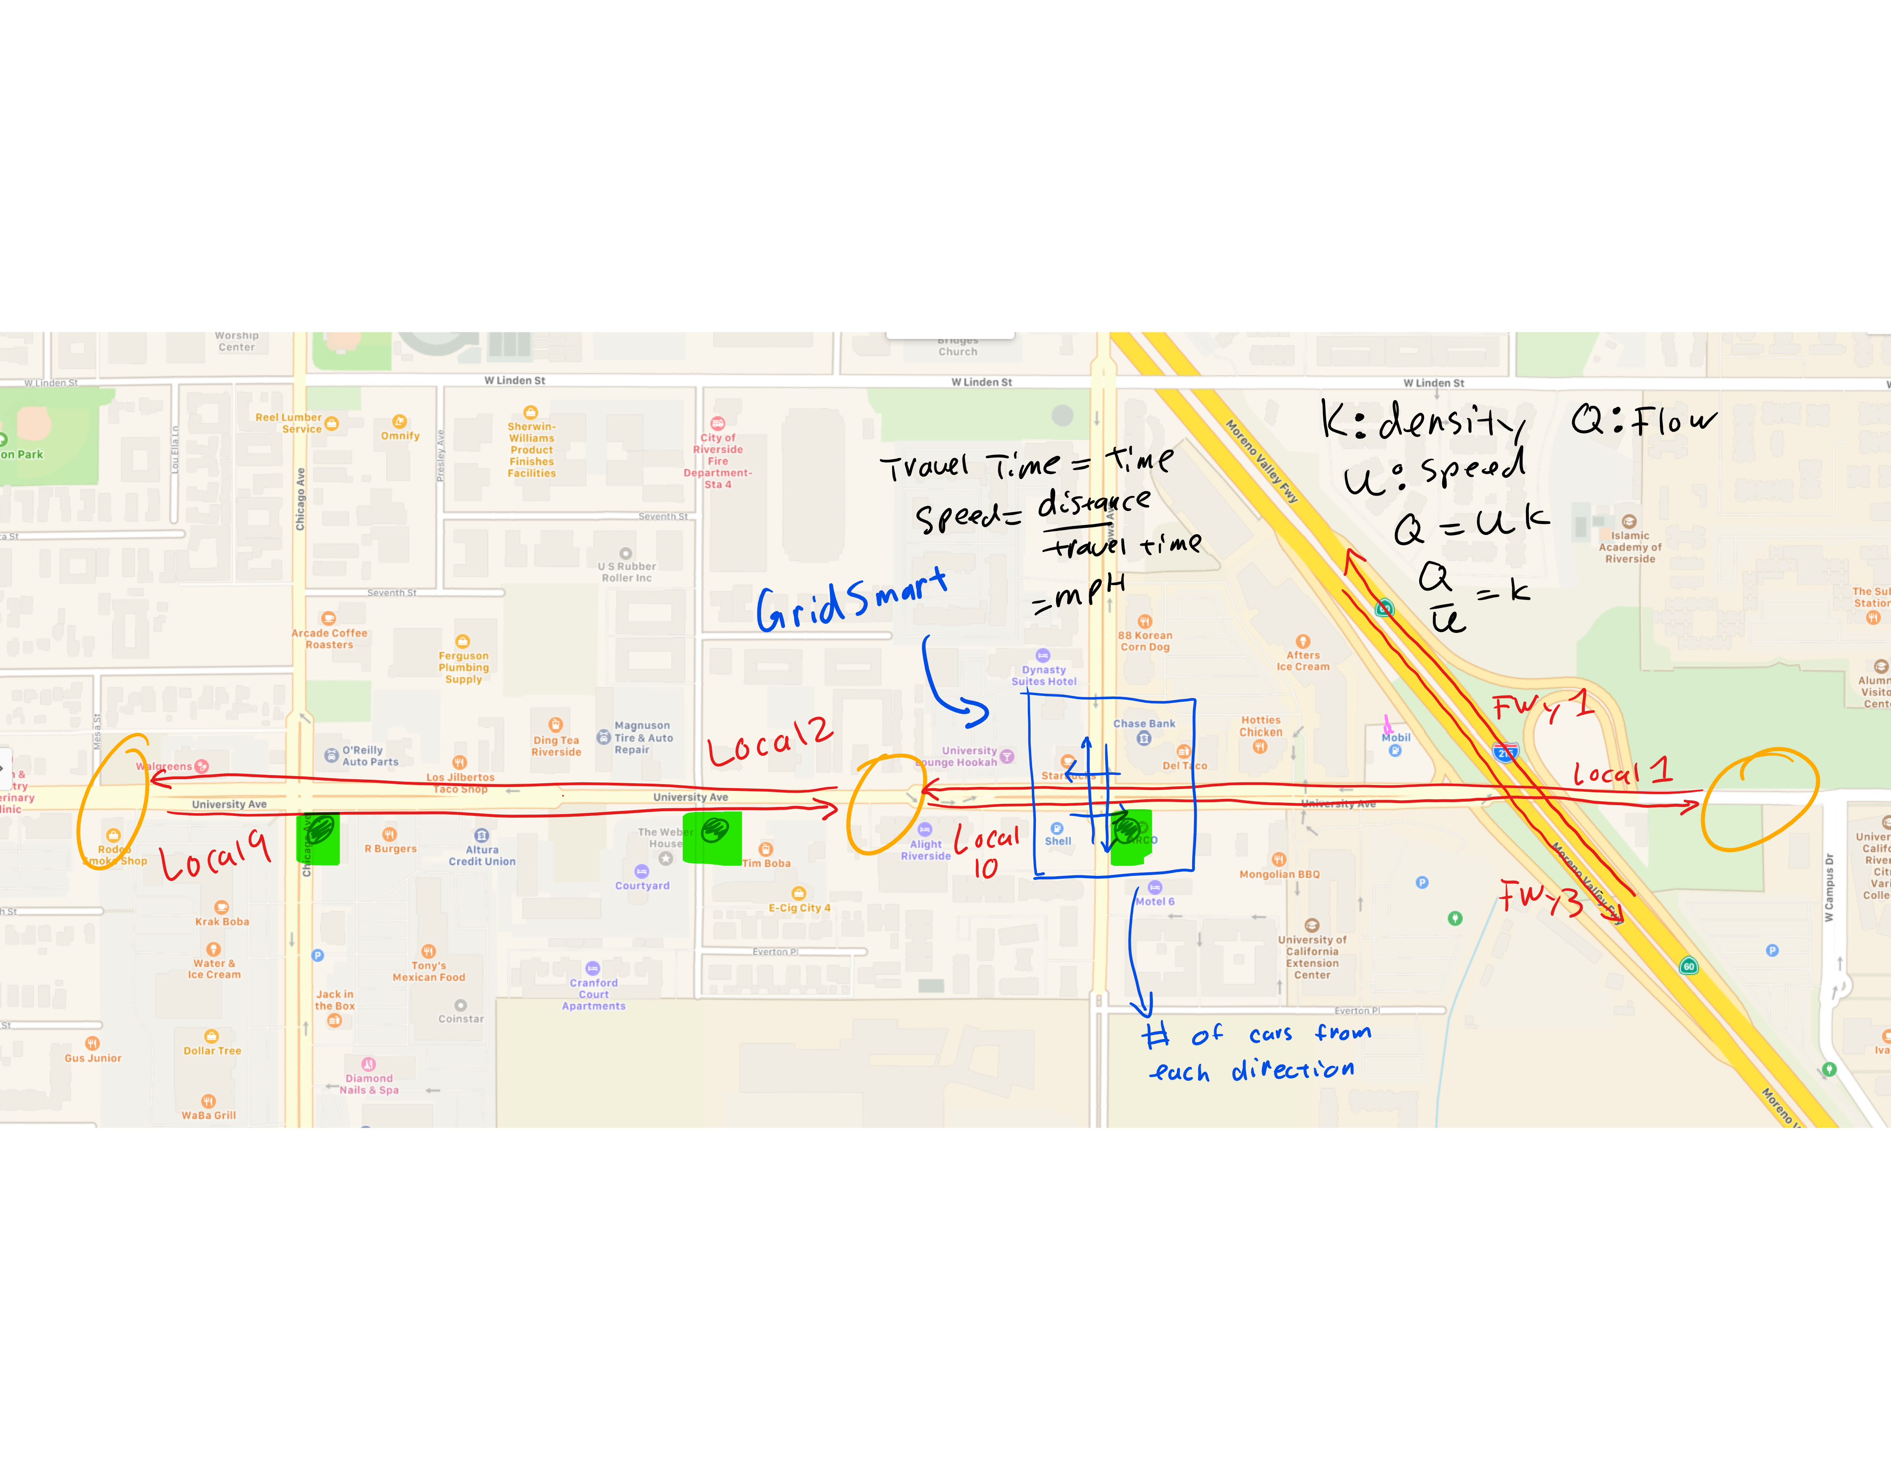
Innovation corridor

Slide 7
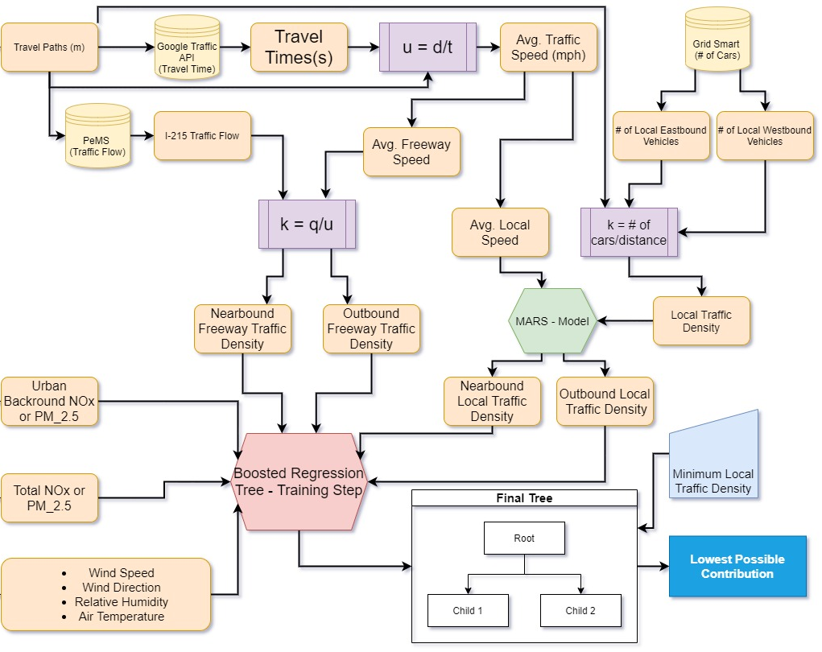
BRT Flow Chart
q: Traffic Flow
t_{travel}: travel time
u: Traffic Speed
k: Traffic Density
v_{wind:}: Wind Speed (m/s)
Local Contribution=
Total – Minimum Contribution

Slide 8
Final tree inputs
Urban Background NOx/PM2.5
Total NOx/PM2.5
Wind Speed
Wind Direction
Relative Humidity
Air Temperature
Nearbound Freeway Traffic Density
Outbound Freeway Traffic Density
Nearbound Local Traffic Density
Outbound Local Traffic Density

Slide 9
Project final timeline
August
Establish a final predictive methodology that shows potential to predict local emissions
Utilize local public access meteorology station to generate a prototype
September
Setup meteorology station upon delivery
Obtain as much data as possible for analysis
(ideally an extension would help improve the predictive ability for the model)

